Slide 1
Object-Oriented Programming (OOP) in Python

Slide 2
Object-Oriented Programming(OOP)
OOP is a programming paradigm that allows us to structure programs in a way that properties (or attributes) and behaviours of real things are combined into separated objects. In other words, real objects are modelled as program objects.
OOP organises programs around objects that combine data (attributes) and behaviour (methods).
  Example: An object can represent a person with a name, age, address, height, etc. the behaviours of that person could be walking, talking and running.

Slide 3
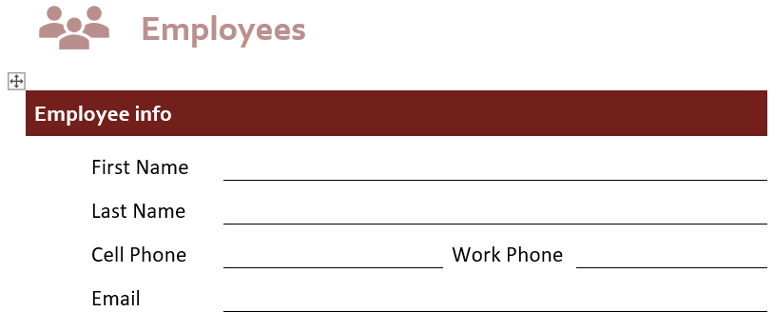
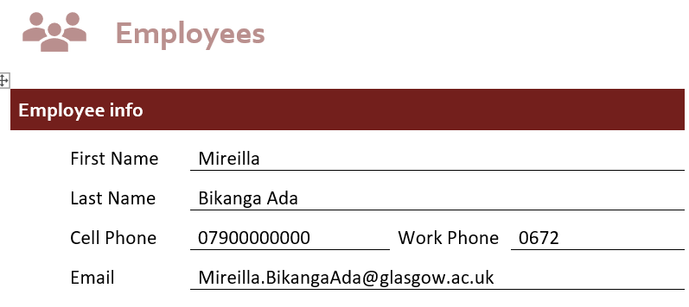
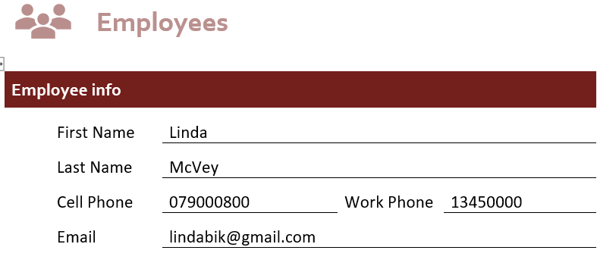
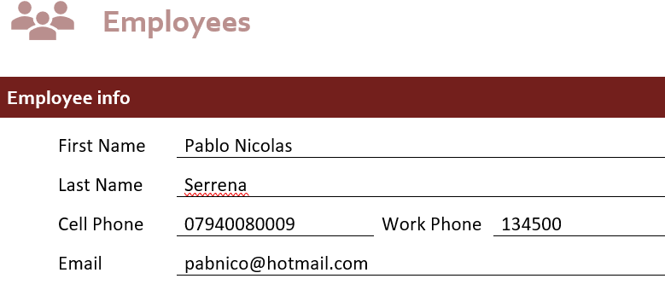
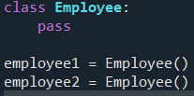
Python Classes and Objects (Instances)
A class is a program template that allows us to create objects. It is a blueprint for creating objects.
The keyword class is used to create a class.
For example we could create a Employees() class that will indicate that the name and other details that are required.
A class does not tell us what the name or other details are. It is an abstract concept. A class helps organise information. We can think of a class as an empty form.
An instance is a copy of a class with actual values; it is a specific object created from that class. Many copies can be created. But we need the class (form) to know what information is required. Creating an object of a class is called instantiation.
employee1 and employee2 are different instances of the Employee class.

Slide 4
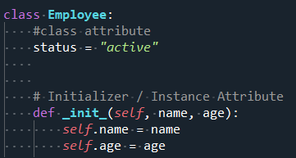
Instance Attribute & Class Attribute
Class create objects. All objects contains characteristics called attributes (properties).
The init () is a special method that is automatically called after a new instance is created. It is commonly used to initialise instance attributes.
The init () method should have at least one argument. self refers to the current object (instance) of the class. It is used to access that object's attributes and methods.
self.name means the name attribute belonging to that particular Employee object.
self is the standard Python convention for the first parameter of an instance method.
__init__() is often informally referred to as the constructor in introductory Python teaching, but its main role is to initialise a newly created object.
Although each employee has a unique name and age, each employee will be active (currently employed)
Instance attributes are specific to each object.
Class attributes are the same for ALL instances.

Slide 5
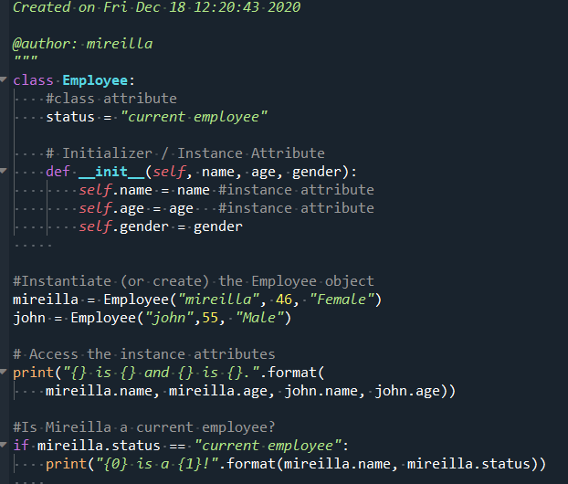
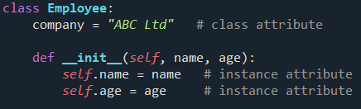

Class Employee
Another example class vs attribute

Slide 6
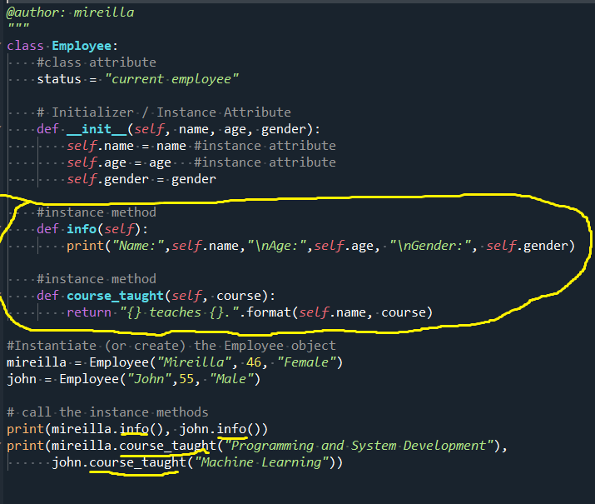
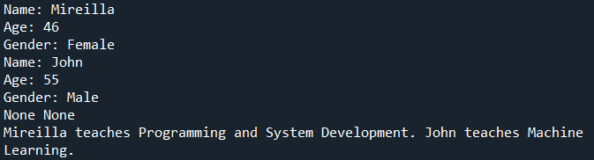
Instance Methods
Instance methods define behaviour for an object and can access or modify its instance attributes through self.

Slide 7
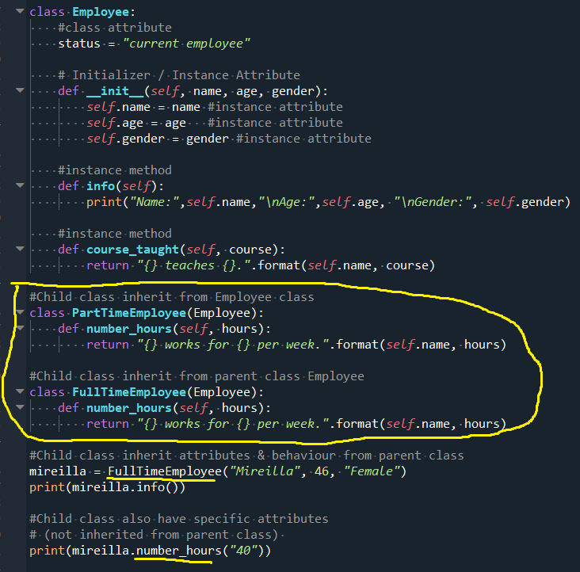
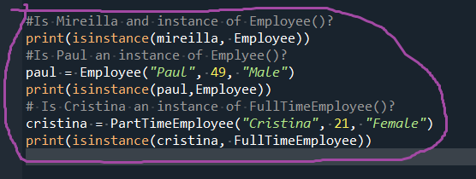

Python Object Inheritance
Inheritance allows a child class to reuse and extend behaviour from a parent class.
Child class: newly created class.
Parent class: a class from which a child class derives.
Child class overrides or extends functionalities: It will take (inherit) all the attributes and behaviour of a parent class and can define further behaviours.
To determine if the instance is an instance of a specific parent class, use isinstance()

